Slide 1
ML – House price prediction using Regression Algorithms
Shashank Singh
Nov 2020

Slide 2
Problem Statement
House is the basic necessity of every Individual. Purchasing it is one of the biggest decision of life. The biggest factor influencing the buying decision is the House price.
For both Buyer and Seller the “right price” is important.
We are going to work on the House data to make a model which will learn the best way to predict the most optimum price based on many features that impact decision of buyer and ultimately the price of the house.

Slide 3
Approach
Following steps were taken –
Loading and analyzing the data
Basic data processing – Visualizing/Cleaning etc
Feature Engineering
Creating Linear Regression model
Evaluating the model
Based on the result more data processing done for feature selection
Recreate the model and evaluate again.
Final model ready for deployment.

Slide 4
Analyzing the Data
There were 1460 observation and 80 features including target variable i.e. Sales Price.
Distribution was as follows –
19 features had 1 or more missing values.
Out of 19, 4 had more then 80% missing values.
Features Types | Total | No. of Features with Missing values | No. Features with no missing values
Categorical | 43 | 16 | 27
Numerical | 37 | 3 | 34
Total | 80 | 19 | 61

Slide 5
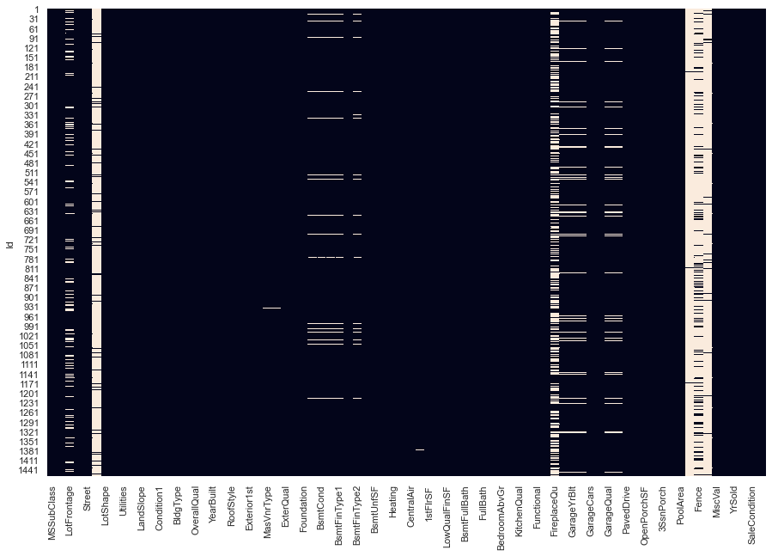
Visualization for Missing values

Slide 6
Data Visualization & Clean up
Features with more then 80% missing values were dropped.
For remaining 15 features, missing values were replaced with median for Numerical features and with mode for Categorical features.

Slide 7
Feature Engineering
Categorical features handling –
39 columns were analyzed for OHE and Label Encoding
After analysis, One Hot Encoding was performed.
Column count became 236 from 76.
Numerical features handling –
37 columns were analyzed
Majority of them had discrete numeric values, so how extra processing done.
For remaining features distribution curve against Sale price was plotted.
10 features did not had Gaussian distribution. Hence Log transformation was performed.
Standard Scaling was then performed for 36 features except Target feature.

Slide 8
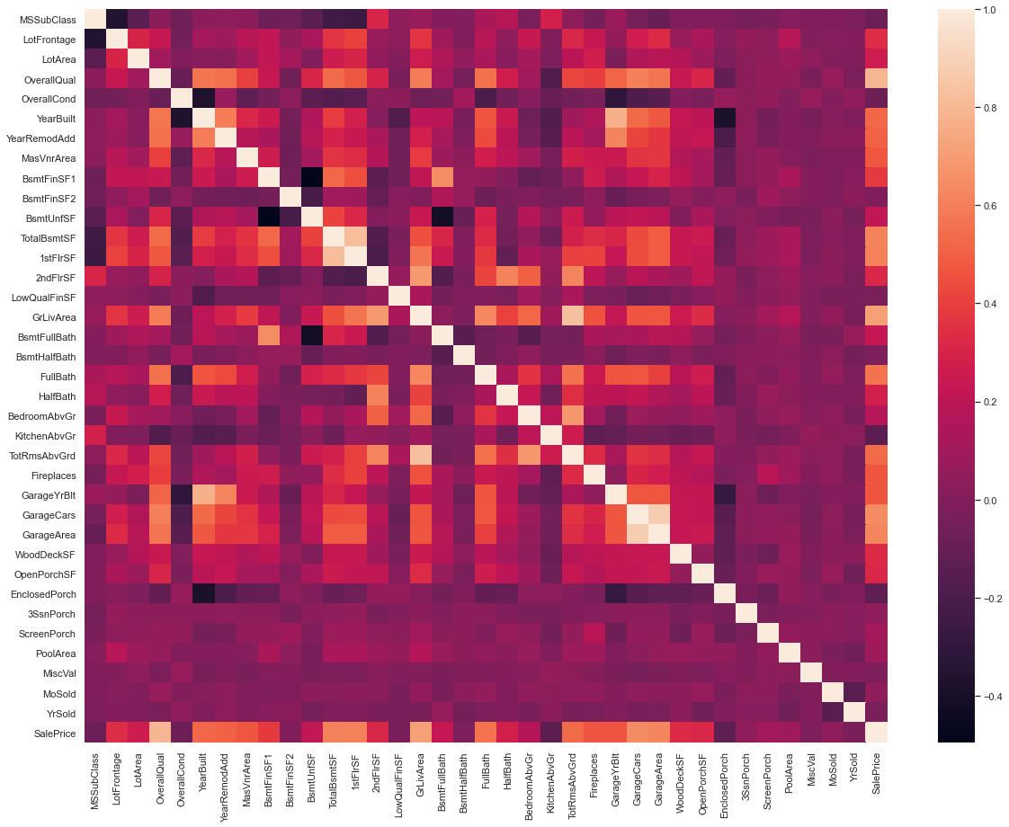
Correlation plot for Numerical Features

Slide 9
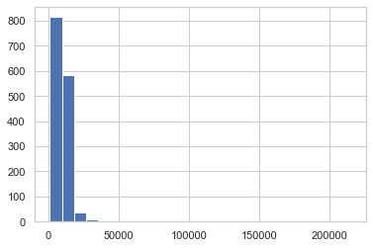
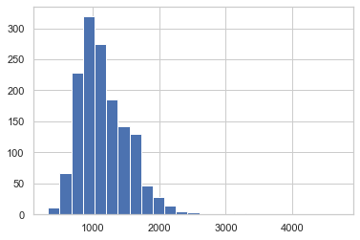
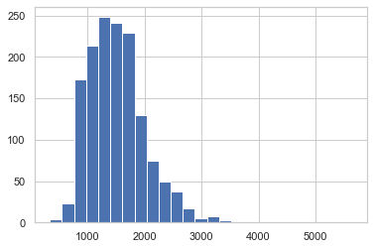
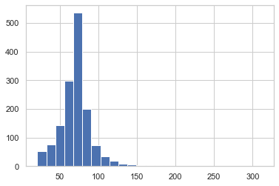
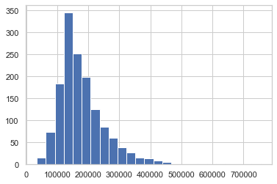
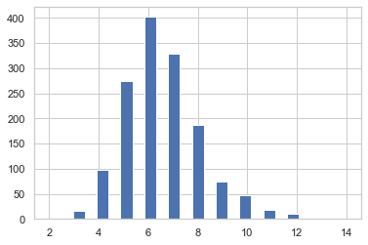
Skewed distribution plot – Need Log Transformation

Slide 10
Model Creation and Evaluation I
For final data set containing 1460 rows and 236 columns, Linear regression model with and without GridSearchCV was created and executed.
Here are the results-
R squared Score for train data = 0.95
R squared Score for test data = -0.00148
Conclusion – Score is excellent for Train data and unacceptable for test data. Clear case of Over fitting (Low Bias, High Variance)
Hence we concluded that need to work on the feature set to make it more effective.

Slide 11
Additional Data processing & Feature Engineering
Applied Lasso regression for best parameter(alpha) and score for feature selection using SelectFromModel.
The relevant feature count became 69 from 236.
A final dataset with relevant features was created for further processing.

Slide 12
Model Creation and Evaluation II
For reengineered final data set containing 1460 rows and 69 columns, Linear regression model with and without GridSearchCV was created and executed.
Here are the results-
R squared Score for train data = 0.917
R squared Score for test data = 0.909

Slide 13
Summary
1st Model created with 236 features gave excellent result for Train dataset. But for Test Dataset result was very poor. A classic case of over fitting.
R squared Score for train data = 0.95
R squared Score for test data = -0.00148
We then used Lasso Regression for important feature selection. The data set reduced to 69 features from 236 features originally.
R squared Score for train data = 0.917
R squared Score for test data = 0.909

Slide 14
Conclusion
Finally our model is ready for deployment to predict house prices for new data with 90.9% accuracy.

Slide 15
Thank you

